Slide 1
How to Abstract for a Computer System?
Prof. Zhang Gang
The Department of Computer Science & Technology TJRAC, China
gzhang@tju.edu.cn
2016.09

Slide 2
Do you know what is the abstraction of a computer system?
The most people may be to say: I know it!
Memory unit
Control unit
Arithmetic/Logic unit
Input device
Output device
This answer is not entirely correct!
This is the abstraction of function units for a computer system.
Not a fundamental abstraction
Why?

Slide 3
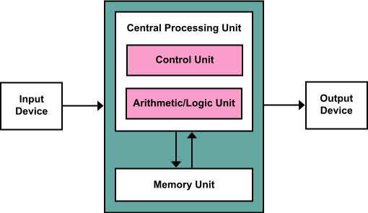
von Neumann architecture
It also known as the von Neumann model and Princeton architecture
Data and instructions are stored in a same memory
Function units
Memory unit
Control unit
Arithmetic/Logic unit
Input device
Output device
It is more applicable to the general-purpose computers

Slide 4
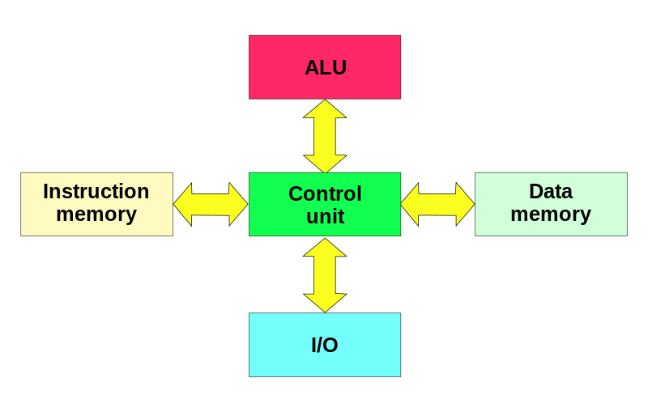
Harvard architecture
Data and instructions are stored in separated storage
And they have separated signal pathway
Function units
Instruction memory unit
Data memory unit
Control unit
Arithmetic/Logic unit
Input/output device
It is more applicable to the special purpose computer
Why?

Slide 5
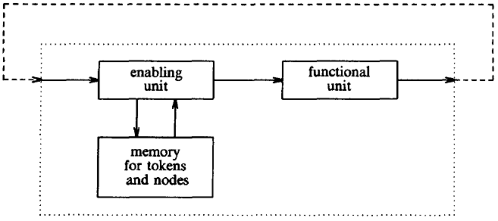
Dataflow architecture
The figure is functional diagram of a processing element.
enabling unit
functional unit
Memory for tokens and nodes

Slide 6
Dataflow architecture
The enabling unit accepts tokens from the left and stores them at the addressed node.
If this node is enabled, an executable packet is sent to the functional unit where it is processed.
The output tokens, with the destination addresses, are sent back to the enabling unit.

Slide 7
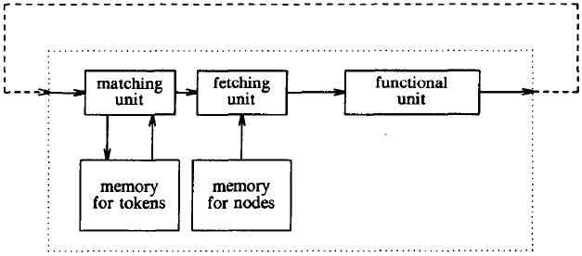
Dataflow architecture
This is a functional diagram of a processing element of a tagged-token machine
The matching unit stores tokens in its memory and checks whether an instance of the destination node is enabled
When all tokens have arrived, they are sent to the fetching unit by matching unit
Fetching unit combines tokens with a copy of the node description into an executable packet to be passed on to the functional unit

Slide 8
Conclusion
From the previous examples, we can draw a conclusion.
The computer systems with different architectures may have different functional units!
So, the abstraction of functional units for a computer system is not fundamental abstraction.
How to abstract a computer system?

Slide 9
2.1. The three fundamental abstractions
The three abstractions are
the memory
the interpreter
the communication link
Supplying fundamental functions of
recall
processing
communication
These are the only hardware abstractions
widely useful
have understandably simple interface semantics

Slide 10
2.1.1 Memory
Memory is the system component that remembers data values for use in computation
All memory devices fit a simple abstract model
WRITE (name, value)
value ← READ (name)
One can recall that value by name in the future
Memory
random-access volatile memory
READ/WRITE model
Storage
non-volatile memory
GET/PUT model
Hardware memory devices:
CMOS RAM
Flash memory
Magnetic tape
Magnetic Disk
CD-R and DVD-R
Higher level memory systems:
RAID
File system
Database management system

Slide 11
Read/write coherence and atomicity
Read/write coherence
the result of the READ of a named value is always the same as the most recent WRITE to that value
Before-or-after atomicity
the result of every READ or WRITE is as if that READ or WRITE occurred either completely before or completely after any other READ or WRITE

Slide 12
Read/write coherence and atomicity
Concurrency
different actors can perform READ and WRITE operations concurrently
they may initiate two such operations on the same named value at about the same time
Needs some kind of arbitration that decides which one goes first and to assure that one operation completes before the other begins

Slide 13
Memory names and addresses
Location-addressed memory
geometric coordinates
consecutive integer
Associative memory
unconstrained names

Slide 14
2.1.2 Interpreters
Interpreters
the active elements of a computer system
they perform the actions that constitute computations
Many systems have more than one interpreter
Hardware:
Pentium 4, PowerPC 970, UltraSPARC T1
disk channel, display controller
Software:
Alice, AppleScript, Perl, Tcl, Scheme
TeX, LaTeX
JavaScript, Smalltalk
LISP, Python, Forth, Java bytecode
Safari, Internet Explorer, Firefox

Slide 15
2.1.2 Interpreters
Interpreters can be described with a simple abstraction, consisting of just three components:
1. instruction reference
which tells the interpreter where to find its next instruction
2. repertoire
which defines the set of actions the interpreter is prepared to perform
3. environment reference
which tells the interpreter where to find its environment
the current state of a system is the environment
on the current state the interpreter should perform the action of the current instruction

Slide 16
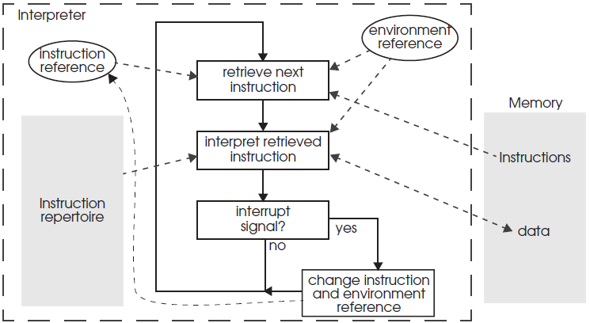
The structure of an abstract interpreter
1 procedure INTERPRET()
2 do forever
3 instruction ← READ (instruction_reference)
4 perform instruction in the context of environment_reference
5 if interrupt_signal = TRUE then
6 instruction_reference ← entry point of INTERRUPT_HANDLER
7 environment_reference ← environment ref of INTERRUPT_HANDLER

Slide 17
2.1.2 Interpreters
A general-purpose processor is an implementation of an interpreter
a program counter looks as the instruction reference
registers look as the environment reference
repertoire includes instructions such as ADD, SUB, CMP, JMP, LOAD, STORE, and so on

Slide 18
2.1.3. Communication links
Communication link
providing a way for information to move between physically separated components
Hardware technology:
twisted pair
coaxial cable
optical fiber
Higher level:
Ethernet
Universal Serial Bus (USB)
the Internet
the telephone system
a Unix pipe

Slide 19
2.1.3. Communication links
The communication link can be abstracted as:
SEND(link_name, outgoing_message_buffer)
RECEIVE(link_name, incoming_message_buffer)
Can we use the READ and WRITE, which used to abstract the memory, to abstract the communication link?
Why?

Slide 20
Reference
PRINCIPLES OF COMPUTER SYSTEM DESIGN: AN INTRODUCTION
Jerome H. Saltzer
M. Frans Kaashoek
Department of Electrical Engineering and Computer Science Massachusetts Institute of Technology

Slide 21
Chapter 2 Elements of Computer System Organization
2.1. The three fundamental abstractions
2.2. Naming in computer systems
2.3. Organizing computer systems with names and layers
2.4. Looking back and ahead

Slide 22
Thank you!

