Slide 1
How to enforced modularity in software system
Prof. Zhang Gang
The Department of Computer Science & Technology TJRAC, China
gzhang@tju.edu.cn
2016.10

Slide 2
Content
1 Coupling
2 From soft modularity to enforced modularity
3 Client/service organization

Slide 3
1 Coupling
Coupling is the measure of the interdependence of one module to another.
Modules are independent if they can function completely without the presence of the other.
Obviously, can't have modules completely independent of each other.
Must interact so that can produce desired outputs.

Slide 4
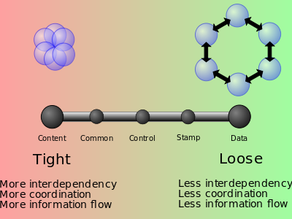
1 Coupling
Types of coupling
Content coupling
Common coupling (Global coupling)
External coupling
Control coupling
Stamp coupling (Data-structured coupling)
Data coupling
Message coupling
No coupling

Slide 5
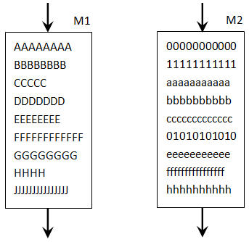
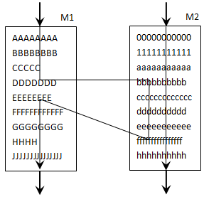
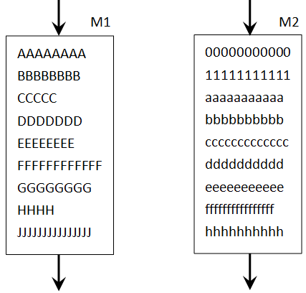
1.1 Content coupling
Two modules are content coupled if:
one module changes a statement in another
one module references or alters data contained inside another module
one module branches into another module
They can happen in assembly language

Slide 6
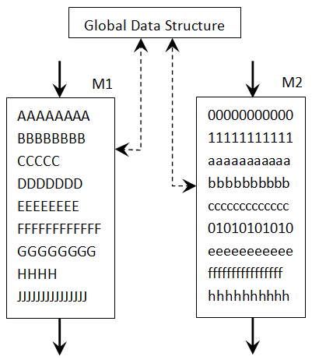
1.2 Common coupling
Also known as global coupling
Share same global data area
access to global data area
modules bound together by global data structures

Slide 7
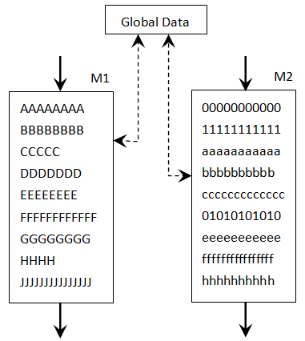
1.3 External coupling
External coupling is very much like the common coupling
Share same global data (global simple variable)

Slide 8
1.4 Control coupling
Pass control flags (as parameters or global) so that one module controls the sequence of processing steps in another module.
// Module A function do(what){ if(what == 1) do_add; else if(what == 2) do_sub;
else if(what==3) do_mul;
else if(what==4) do_div; } // Module B A.do(1);

Slide 9
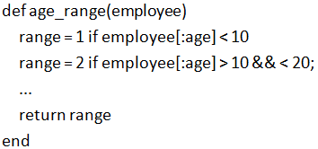
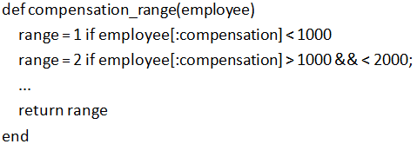
1.5 Stamp coupling
Also known as data-structured coupling
Pass entire data structure but need only parts of it.
e.g. pass a whole record to a function which only needs one field of it

Slide 10
1.5 Stamp coupling
There are two problems
The modules being called must be aware of the data structure
How many fields in the data structure?
What is the name of each field in the data structure?
If the data structure changes, those modules have to change.

Slide 11
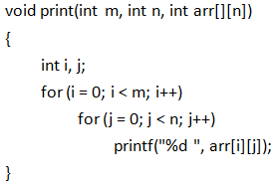
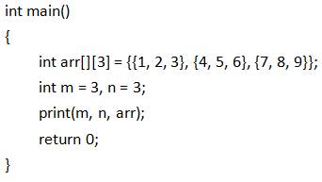
1.6 Data coupling
Two modules communicate by passing parameters.
use of parameter lists to pass data items
"good design principle"

Slide 12
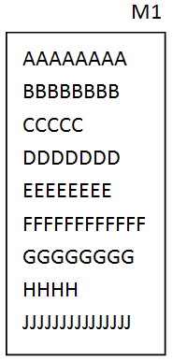
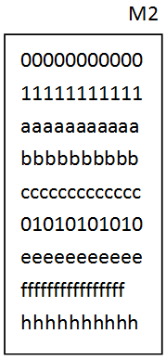
1.7 Message coupling
Modules interact only by sending messages.
not dependent on each other
use a public interface to exchange parameter
Send message
Receive message
Request
Response

Slide 13
2. From soft modularity to enforced modularity
Soft modularity limits interactions of correctly implemented modules to their specified interfaces, but implementation errors can cause interactions that go outside the specified interfaces.
To enforce modularity we desire hard boundaries between modules so that errors cannot easily propagate from one module to another

Slide 14
2 From soft modularity to enforced modularity
A simple program that measures how long a function runs.

Slide 15
2 From soft modularity to enforced modularity
This boundary between GET_TIME and its caller, however, is soft.
Although procedure call is a primary tool for modularity, errors can still leak too easily from one module to another.
It is obvious that if GET_TIME returns a wrong answer, the caller has a problem.
an infinite loop in a called procedure
It is less obvious that programming errors in GET_TIME can cause trouble for the caller even if GET_TIME returns a correct answer.
Why？

Slide 16
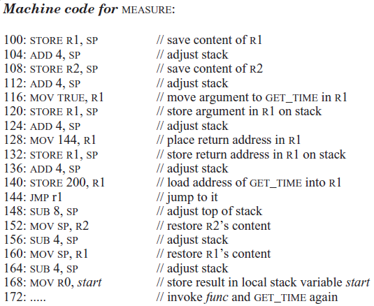
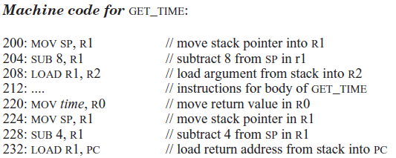
MEASURE and GET_TIME use a same stack to transact the data
The Call in high-level language is actually JMP in low-level language
R0 is used to transact the time

Slide 17
2 From soft modularity to enforced modularity
If the callee not stores return values in register R0, the caller probably perform an incorrect computation.
If the callee have changed the content of the temporary registers which stored in stack, caller probably performs an incorrect computation.
If the callee divides by zero and, as a result, terminates, the caller may terminate too.
This effect is known as fate sharing.

Slide 18
2 From soft modularity to enforced modularity
What we desire in systems is enforced modularity
modularity is enforced by some external mechanism
This external mechanism limits the interaction among modules to the ones we desire.
Such a limit on interactions reduces the number of opportunities for propagation of errors, it allows verification that a user uses a module correctly, and it helps prevent an attacker from penetrating the security of a module.

Slide 19
3 Client/service organization
One good way to enforce modularity is using client/service model which limited the interactions among modules to explicit messages.
A client is a piece of computer hardware or software that accesses a service made available by a server.
An instance of a service running on a single computer is called a server.
The server is often (but not always) on another computer system.

Slide 20
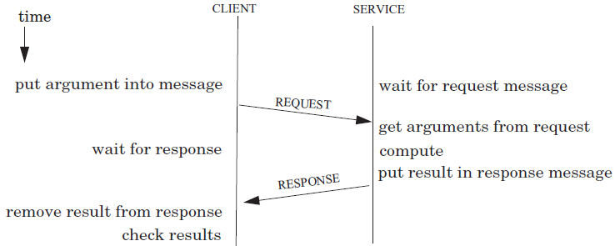
3 Client/service organization
Conceptually the client/service model runs clients and services on separate computers, connected by a wire.
The implementation restricts all interactions to well-defined messages sent across a wire.

Slide 21
3 Client/service organization
The disadvantage of this implementation is that it requires one computer per module.
may be costly in equipment

Slide 22
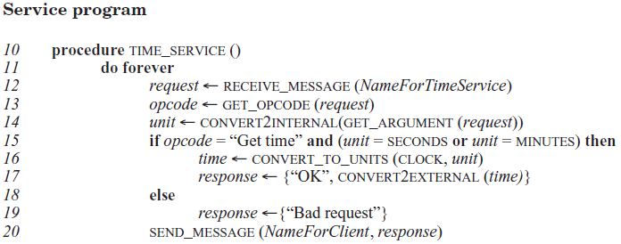
Example client/service application: time service

Slide 23
3 Client/service organization
The client/service organization not only separates functions (functional modularity), it also enforces that separation (enforced modularity).
The advantages of client/service organization
don’t rely on shared state
arm’s-length transaction
client can protect itself
Explicit and well-defined interfaces

Slide 24
3 Client/service organization
The client/service organization is an example of a sweeping simplification
The model eliminates all forms of interaction other than messages
The model create a firewall between client and service.
Clients (or service) can be mostly independent of service (or clients) failures
The client/service organization reduces fate-sharing, but doesn’t eliminate it.

Slide 25
3 Client/service organization
The World Wide Web is a nice example.
widely-used system
organized in a client/service style
client and service running on separate computers
Web browser is a client and a Web site is a service
The World Wide Web provides enforced modularity

Slide 26
Reference
PRINCIPLES OF COMPUTER SYSTEM DESIGN: AN INTRODUCTION
Jerome H. Saltzer
M. Frans Kaashoek
Department of Electrical Engineering and Computer Science Massachusetts Institute of Technology

Slide 27
Chapter 4 Enforcing Modularity with Clients and Services
4.1. Client/service organization
4.2. Communication between client and service
4.3. Summary and the road ahead
4.4. Case study: The Internet Domain Name System (DNS)
4.5. Case study: The Network File System (NFS)

Slide 28
Thank you!

