Slide 1
How to Enforcing Modularity with Virtualizing Memory?
Prof. Zhang Gang
The Department of Computer Science & Technology TJRAC, China
gzhang@tju.edu.cn
2016.11

Slide 2
Contents
Review
Enforcing modularity with threads and address spaces
Virtual memory
How to translate a virtual address to a physical address?
Virtual address space
The use of several address spaces
The advances of using virtual address

Slide 3
Review
Preemptive scheduling enforces modularity in the sense that one thread cannot stop the progress of another thread, but if all threads share a single address space then they can modify each other’s memory accidently.
That may be OK for threads that are working together on a common problem, but unrelated threads need to be protected from erroneous or malicious stores of one another.

Slide 4
Enforcing modularity with threads and address spaces
This protection can be provided by making the thread manager aware of the virtual address spaces
When thread manager switches a processor from one thread to another, also switch the address space.

Slide 5
Enforcing modularity with threads and address spaces
ENTER_PROCESSOR_LAYER saves the contents of the processor’s PMAR into the threadtable entry of the thread that is releasing the processor
EXIT_PROCESSOR_LAYER loads the processor’s PMAR with the value in the threadtable entry of the new thread

Slide 6
Enforcing modularity with threads and address spaces
What is the PMAR?
PMAR means Page Map Address Register
Page map address register (PMAR) pointing to the page map that defines the thread’s address space.
What is the page map?

Slide 7
Virtual memory
Virtual memory is a memory management technique that is implemented using both hardware and software.
The memory addresses used by a program called virtual addresses
Or the addresses of virtual memory called virtual addresses

Slide 8
Virtual memory
A memory manager that virtualizes memory is called a virtual memory manager
A virtual memory manager translating virtual addresses to physical addresses.
A physical address is a bus address of a location in memory

Slide 9
Virtual memory
From a naming point of view, the virtual memory manager creates a name space of virtual addresses on top of a name space of physical addresses.
The virtual memory manager’s naming scheme translates virtual addresses into physical addresses.

Slide 10
How to translate a virtual address to a physical address?
A efficient way of translation is using a page map.
The page map is an array of page map entries.
Each entry translates a page to a block which holds the page.
A fixed-sized range of contiguous bytes of virtual addresses, called a page

Slide 11
How to translate a virtual address to a physical address?
A range of physical addresses, called a block
We can think of a block as the container of a page.
The memory manager maintains a single page map
So that all threads share the single virtual address space, as before.
The threads issue virtual addresses when reading and writing to memory.

Slide 12
How to translate a virtual address to a physical address?
With this organization, the memory that threads see as a set of contiguous pages.
A virtual address consist of two parts:
a page number
a byte offset within that page

Slide 13
How to translate a virtual address to a physical address?
Physical memory is a contiguous set of blocks, holding pages, but the pages don’t have to be contiguous in physical memory
block 0 may hold page 100
block 1 may hold page 2, etc.
A physical address can be viewed as having also two parts:
a block number that uniquely identifies a block of memory
an offset that identifies a byte within that block

Slide 14
How to translate a virtual address to a physical address?
Translating a virtual address to a physical address is now a two-step process:
1. translates the page number to a block number that holds that page
2. computes the physical address by concatenating the block number with the byte offset

Slide 15
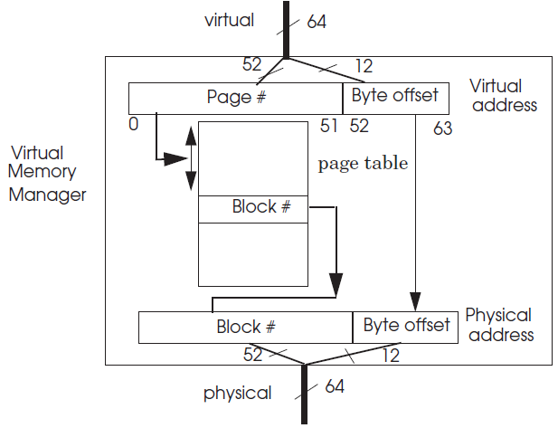
How to translate a virtual address to a physical address?
The simplest implementation of a page map is an array implementation, often called a page table.

Slide 16
How to translate a virtual address to a physical address?
How to storing the page table that used by virtual memory manager?
In the usual implementation
the page table is stored in the same physical memory that holds the pages
the physical address of the base of the page map is stored in a reserved processor register
typically named the Page Map Address Register

Slide 17
How to translate a virtual address to a physical address?
To ensure that user-level threads cannot change translation directly and break hard modularity
Page Map Address Register be allow to write by its threads only in kernel mode
The page table be allow to modify directly by the kernel only

Slide 18
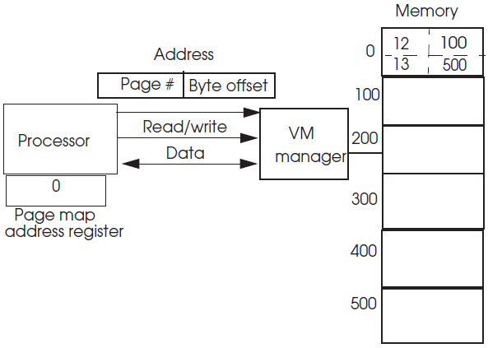
How to translate a virtual address to a physical address?
The kernel has allocated a page map in physical memory at address 0
block 100 contains page 12
block 500 contains page 13

Slide 19
The basic abstracts of interface for virtual memory
id ←CREATE_ADDRESS_SPACE (): create a new address space
This address space is empty, meaning that none of its virtual pages are mapped to real memory.
CREATE_ADDRESS_SPACE returns an identifier for that address space.

Slide 20
The basic abstracts of interface for virtual memory
block ← ALLOCATE_BLOCK (): ask the memory manager for a block of memory
The manager attempts to allocate a block that is not in use.
ALLOCATE_BLOCK returns the physical address of the block.
If there are no free blocks, the request fails.

Slide 21
The basic abstracts of interface for virtual memory
MAP (id, block, page_number, permission): put a block into id’s address space.
MAP maps the physical address block to virtual page with permissions.
The memory manager allocates an entry in the page map for address space id, mapping the virtual page page_number to block block, and setting the page’s permissions to permission.

Slide 22
The basic abstracts of interface for virtual memory
UNMAP (id, page_number): remove the entry for page_number from the page map so that threads have no access to that page and its associated block.
An instruction that refers to a page that has been deleted is an illegal instruction.

Slide 23
The basic abstracts of interface for virtual memory
FREE_BLOCK (block): add the block to the list of free memory blocks.
DELETE_ADDRESS_SPACE (id): destroy an address space.
The memory manager frees the page map and its blocks of address space id.

Slide 24
The basic abstracts of interface for virtual memory
Using this interface, a thread may allocate its own address space or share its address space with other threads.

Slide 25
Virtual address space
The virtual address space is a thread’s domain and the page map defines how it resides in physical memory.
Thus the kernel doesn’t have to maintain a separate domain table with domain registers.
If a physical block doesn’t appear in an address space’s page map
then the thread cannot make a reference to that physical block

Slide 26
Virtual address space
If a physical block appears in two page maps, then threads in both address spaces can make references to that physical block
which allows sharing of memory
In pseudocode, the page table is indexed by a page number and stores the corresponding block number

Slide 27
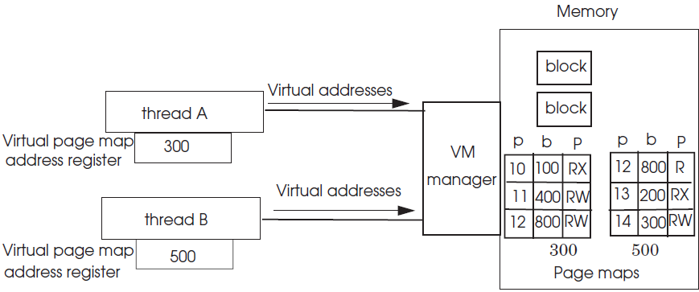
The use of several address spaces
There two threads, A and B, each with their own address space
but sharing block 800
Threads A and B have block 800 mapped at page 12

Slide 28
The advances of using virtual address
Translating addresses as they are being used provides design flexibility.
physical addresses have a different width than virtual addresses
several virtual addresses can be translated to the same physical address
but perhaps with different permissions
The virtual addresses can be allocated to a thread, but postpone allocating physical memory until the thread makes a reference to one of the virtual addresses.

Slide 29
Reference
PRINCIPLES OF COMPUTER SYSTEM DESIGN: AN INTRODUCTION
Jerome H. Saltzer
M. Frans Kaashoek
Department of Electrical Engineering and Computer Science Massachusetts Institute of Technology

Slide 30
CHAPTER 5 ENFORCING MODULARITY WITH VIRTUALIZATION
5.1. Client/server organization within a computer using virtualization
5.2. Virtual links using SEND, RECEIVE, and a bounded buffer
5.3. Enforcing modularity with domains
5.4. Virtualizing memory
5.5. Virtualizing processors using threads
5.6. Thread primitives for sequence coordination

Slide 31
Thank you!

