Slide 1
How to enforcing modularity with domains?
Prof. Zhang Gang
The Department of Computer Science & Technology TJRAC, China
gzhang@tju.edu.cn
2016.10

Slide 2
Contents
Review
Some conceptions about domain
Allocate and map a new domain
How to control thread to access the domain?
How to check permission by memory manager?
More enforced modularity with kernel and user mode
Enforcing modularity for bounded buffers

Slide 3
Review
The implementation of bounded buffers took advantage that all threads share the same physical memory, but sharing memory does not enforce modularity well.
A program may calculate a shared address incorrectly and write to a memory location that logically belongs to another module.
To enforce modularity we must ensure that the threads of one module cannot overwrite the data of another module.

Slide 4
Some conceptions about domain
1. Domain
A thread’s references is restricted in a contiguous range of memory addresses.
The contiguous range of memory addresses is called domain.
When a programmer calls ALLOCATE_THREAD, the programmer specifies a domain in which the thread is to run.
The thread manager records a thread’s domain.

Slide 5
Some conceptions about domain
2. Domain register
A thread should refer to memory within its domain only
A domain register contains the address ranges that the currently running thread is allowed to use
the lowest address and highest address
Each processor there is a domain register

Slide 6
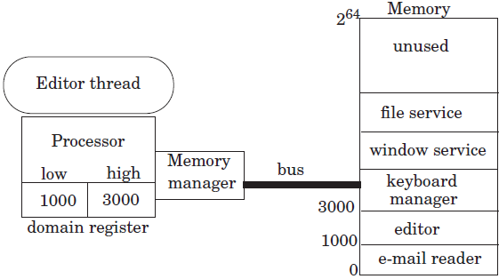
Some conceptions about domain
3. Memory manager
A memory manager is a special interpreter.
A memory manager is typically implemented in hardware and placed between a processor and the bus.
ALLOCATE_THREAD loads the processor’s domain register with the thread’s domain.

Slide 7
Some conceptions about domain
The memory manager checks for each memory reference that the address is equal or higher than low and smaller than high.
If it is, the memory manager issues the corresponding bus request.
If not, it interrupts the processor, signaling a memory reference exception.
The exception handler can then decide what to do.
One option is to deliver an error message and destroy the thread.

Slide 8
Some conceptions about domain
This design ensures that a thread can make references only to addresses that are in its domain.
Threads cannot overwrite or jump to memory locations of other threads.

Slide 9
Some conceptions about domain
4. Share domains
To allow for sharing, each thread is allowed to have several domains, as many as a thread needs.
Each processor is given several domain registers.
Now a designer can partition the memory of the programs and control sharing.

Slide 10
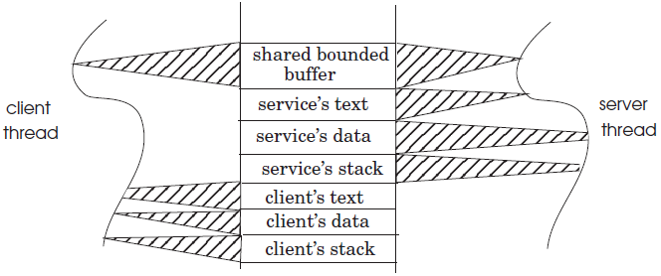
Some conceptions about domain
For example, a client may be split into four separate domains
one domain containing the program text
one domain containing the data
one domain containing the stack
one domain containing the bounded message buffer
A service may be split in the same way.

Slide 11
Allocate and map a new domain
base_address ← ALLOCATE_DOMAIN (size):
allocate a new domain of size bytes and return the base address of the domain.
ALLOCATE_DOMAIN request to allocate size bytes of memory
MAP_DOMAIN (base_address):
Add the domain starting at address base_address to the calling thread’s domains
If two or more threads map a domain, then that domain is shared among those threads.

Slide 12
How to control thread to access the domain?
Memory regions list
record the regions not in use
Domain table
record the base_address and size
MAP_DOMAIN loads the domain’s bounds from the domain table into a domain register of the thread’s processor.
If two or more threads map a domain, then that domain is shared among those threads.

Slide 13
How to control thread to access the domain?
Domain register can be extended to record access permissions for improving the control mechanism
A domain register might include three bits
READ, WRITE, or EXECUTE
which separately control permission to READ, WRITE, or EXECUTE any of the bytes in the associated domain
MAP_DOMAIN will be modified as follows
MAP_DOMAIN (base_address, permission)

Slide 14
How to control thread to access the domain?
A LOAD instruction requires READ permission for its address
memory manager must check that the address is in a domain with READ access
A STORE instruction requires WRITE permission for its address
memory manager must check that the address is in a domain with WRITE access
To execute an instruction at the address in the PC requires EXECUTE permission.

Slide 15
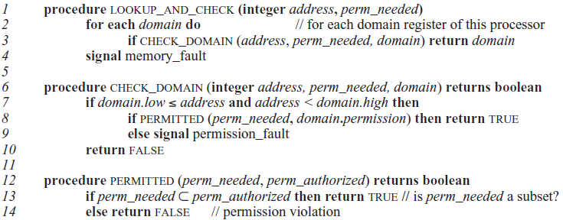
How to check permission by memory manager?
The pseudocode details the check performed by the memory manager.
in practice the memory manager is implemented in hardware integrated with the processor

Slide 16
How to check permission by memory manager?
The memory manager can implement security policies, because it controls which threads have access to which parts of memory.
It can deny or grant a thread’s request for allocating a new domain or for sharing an existing domain.
In the same way, it can control which threads have access to which devices.

Slide 17
More enforced modularity with kernel and user mode
Domain registers restrict the addresses to which a thread can make reference
But a thread can change its domains
Because domain table can be referenced by a thread
So we must also ensure that a thread cannot change its domains
We need a mechanism to control changes to the low, high, and permission fields of a domain register.

Slide 18
More enforced modularity with kernel and user mode
Add one bit to the processor indicating whether the processor is in kernel mode or user mode
Extend the set of permissions for a domain to include KERNEL-ONLY
Instructions can change the value of the processor’s domain registers only in kernel mode.
Similarly, instructions can change the mode bit only in kernel mode.

Slide 19
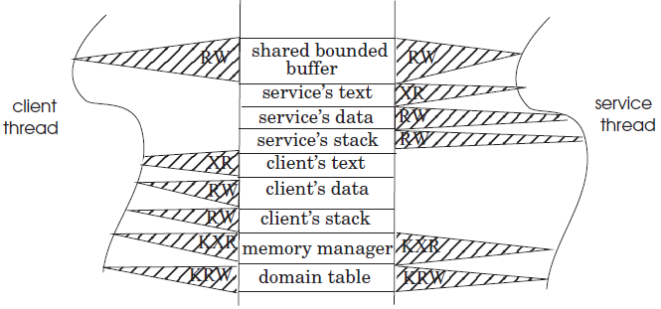
More enforced modularity with kernel and user mode
Using the kernel and user mechanisms, each thread has two additional domains, memory manager and domain table, marked K for KERNEL-ONLY.
So a thread in user mode cannot change its domain information.

Slide 20
Enforcing modularity for bounded buffers
There is a problem in this case.
A thread can modify the shared buffer accidently.
Thus, an error in one thread could indirectly affect the other thread.

Slide 21
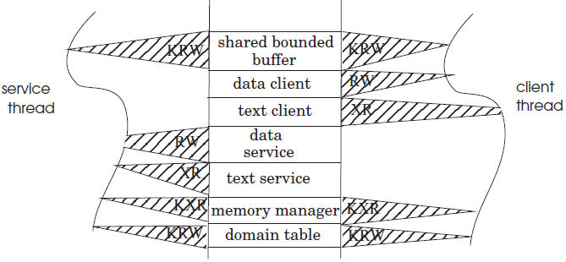
Enforcing modularity for bounded buffers
The shared bounded buffer can be protected by putting the buffer in a shared kernel domain
The threads cannot directly write the shared buffer in user mode.

Slide 22
Enforcing modularity for bounded buffers
The threads must transition to kernel mode to copy messages into/from the shared buffer.
When a thread invokes SEND/RECEIVE, it changes to kernel mode
SEND and RECEIVE are supervisor calls

Slide 23
Enforcing modularity for bounded buffers
Why putting shared bounded buffer in a shared kernel domain can enforced modularity?
The threads in user mode have no direct access to a bounded buffer’s messages
The program running in kernel mode is written more carefully
So this design provides stronger enforced modularity

Slide 24
Reference
PRINCIPLES OF COMPUTER SYSTEM DESIGN: AN INTRODUCTION
Jerome H. Saltzer
M. Frans Kaashoek
Department of Electrical Engineering and Computer Science Massachusetts Institute of Technology

Slide 25
CHAPTER 5 ENFORCING MODULARITY WITH VIRTUALIZATION
5.1. Client/server organization within a computer using virtualization
5.2. Virtual links using SEND, RECEIVE, and a bounded buffer
5.3. Enforcing modularity with domains
5.4. Virtualizing memory
5.5. Virtualizing processors using threads
5.6. Thread primitives for sequence coordination

Slide 26
Thank you!

