Slide 1
How to achieve software modular sharing in naming schemes?
Prof. Zhang Gang
The Department of Computer Science & Technology TJRAC, China
gzhang@tju.edu.cn
2016.09

Slide 2
Content
1. Module
2. Software Module
3. Modularity
4. Modular sharing
4.1 Name conflict
4.2 How to solve the problem of name conflict?
4.3 Using structure to achieve modular sharing

Slide 3
1 Module
A module can include a collection of related components
Modules are independent of one another
But modules can communicate with each other in a loosely coupled fashion

Slide 4
2 Software Module
A software module encapsulates related functions in a program together.
When writing a software module it is important to be aware of what related the functions in the module together.
Software modules typically have their own private data and multiple functions.

Slide 5
2 Software Module
Only the functions in the module can modify the private data in the module.
Software modules are divided into a private implementation and a public interface.
A software module can be used by other module in other projects through the public interface.

Slide 6
3 Modularity
Modularity is the degree to which a system's components may be separated and recombined.
Modularity is designing a system that is divided into a set of functional units (named modules) that can be composed into a larger application
Software comprises well defined, independent components
Leads to better maintainability
Can be implemented and tested in isolation

Slide 7
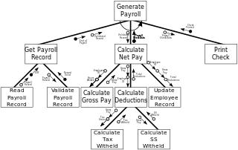
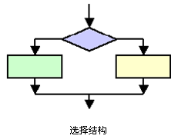
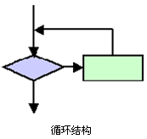
Two concepts that are easily confused
Modular programming
Also called modular design
Emphasizes separating the functionality of a program into independent, interchangeable modules
High-level decomposition of the code of an entire program
Structured programming
The low-level code use of structured control flow

Slide 8
Why Choose a Modular Programming?
Simplified modules
High cohesion in a module
Loose coupling between modules
Developing and deploying modules independently
Modules can be developed, tested, and deployed on independent schedules
When modules are developed in a loosely coupled way
Minimizing download time
Only download modules that are required to start-up the application
The rest are loaded in the background or when they are required

Slide 9
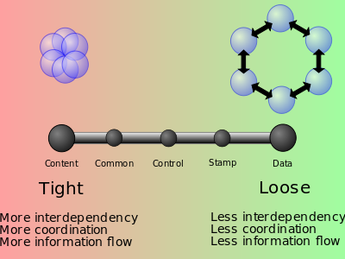
Types of coupling
Content coupling
Common coupling (Global coupling)
External coupling
Control coupling
Stamp coupling (Data-structured coupling)
Data coupling
Message coupling
No coupling

Slide 10
4. Modular sharing
Connecting modules by name provides great flexibility
But it introduces a hazard:
The designer sometimes has to deal with pre-existing names, perhaps chosen by someone else over whom the designer has no control.
This hazard can arise whenever modules are designed independently
Why?

Slide 11
4 Modular sharing
For example:
1. Determine a suitable file name for a file in your computer system
The file name must not be repeated in the folder
2. Determine a suitable user name for an email user in an email system
The user name must not be repeated in the email system
Which name is more difficult to determine?
Why?

Slide 12
4 Modular sharing
Modular sharing
One can use a shared module by name without knowing the names of the modules it uses
Modular sharing is one of the primary goals of modularity
If, in order to use a module, the designer must know about and avoid the names used within that module for its components, we have failed to achieve modular sharing.

Slide 13
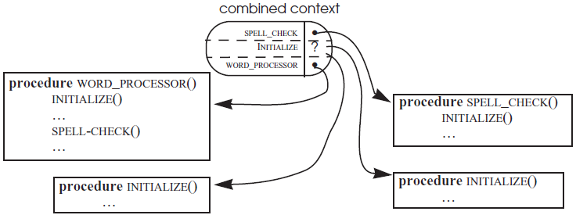
4.1 Name conflict
Name conflict:
Two or more different values compete for the binding of the same name in the same context.
Lack of modular sharing shows up in the form of name conflict

Slide 14
4.1 Name conflict
Name conflict can arise when integrating two (or more) independently conceived something which use the same naming scheme.
sets of programs
sets of documents
file systems
databases
or indeed any collection of components

Slide 15
4.2 How to solve the problem of name conflict?
Name conflict can be a serious problem
because fixing it requires changing some of the uses of the conflicting names.
Making such changes can be awkward or difficult
since the authors of the original subsystems are not necessarily available to help locate, understand, and change the uses of the conflicting names.

Slide 16
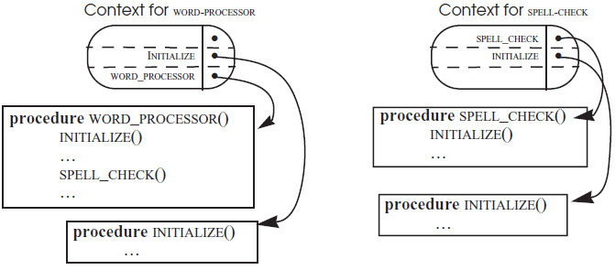
4.2 How to solve the problem of name conflict?
The obvious way to implement modular sharing
provide each subsystem with its own naming context
work out some method of cross-reference between the contexts

Slide 17
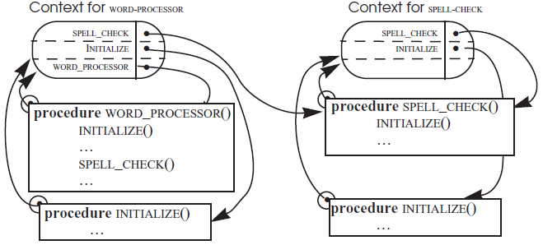
4.2 How to solve the problem of name conflict?
A direct solution would be to add a binding for SPELL_CHECK in the WORD_PROCESSOR context and attach to every module an explicit context reference

Slide 18
4.2 How to solve the problem of name conflict?
The solution, adding a binding in its context, may have two problems
The program interpreter to keep track of the context in which it originally found each program and to use that context for resolving all names found in that program
Modifying the representation of the modules may not be convenient or even not allowed if some of the modules belong to someone else

Slide 19
4.2 How to solve the problem of name conflict?
That extra binding creates a subtle problem that may produce a later surprise.
SPELL_CHECK was found in the word processor’s context by the program interpreter
SPELL_CHECK will use the word processor’s context for the names it finds inside of SPELL_CHECK

Slide 20
4.2 How to solve the problem of name conflict?
E.g.
WORD_PROCESSOR called SPELL_CHECK
SPELL_CHECK will called INITIALIZE
The INITIALIZE in the SPELL_CHECK will use the word processor’s context incorrectly
SPELL_CHECK will call the wrong version of INITIALIZE !

Slide 21
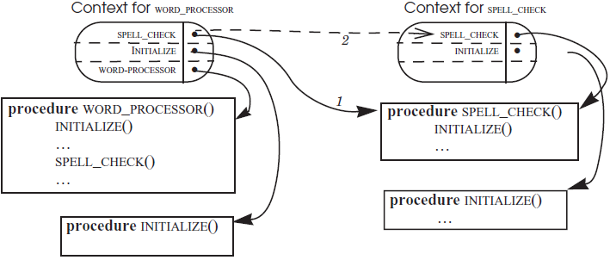
4.2 How to solve the problem of name conflict?
A solution is to place an indirect name, the dashed arrow, in the word processor’s context
It can bind the names, finding in SPELL_CHECK, in SPELL_CHECK’s own context
The interpreter will correctly resolve names found in both groups of programs

Slide 22
4.3 Using structure to achieve modular sharing
Another way of attaching a context reference to an object is to associate the name of an object
not directly with the object itself
A structure consists of the original object plus its context reference.
An example of a structure in C
struct employee
{
int id;
char name[30];
};

Slide 23
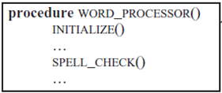
4.3 Using structure to achieve modular sharing
SPELL_GHECK.P2
●
WORD_PROCESSOR.P1
●
P1
Struct_WORD_PROCESSOR
P2
Struct_ SPELL_CHECK
ObjectName WORD_PROCESSOR
ObjectName SPELL_CHECK
WORD_PROCESSOR
●
SPELL_CHECK
●
INITIALIZE
●
INITIALIZE
●
The two modules, P1 and P2, are compiled separately
The two modules are linked by the linker
Static link or dynamic link

Slide 24
Reference
PRINCIPLES OF COMPUTER SYSTEM DESIGN: AN INTRODUCTION
Jerome H. Saltzer
M. Frans Kaashoek
Department of Electrical Engineering and Computer Science Massachusetts Institute of Technology

Slide 25
CHAPTER 3 THE DESIGN OF NAMING SCHEMES
3.1. Considerations in the design of naming schemes
3.1.1. Modular sharing
3.1.2. Metadata and name overloading
3.1.3. Addresses: names that locate objects
3.1.4. Generating unique names
3.1.5. Intended audience; user-friendly names
3.1.6. Relative lifetimes of names, values, and bindings
3.1.7. Looking back and ahead: names are a basic system component

Slide 26
Thank you!

